Slide 1
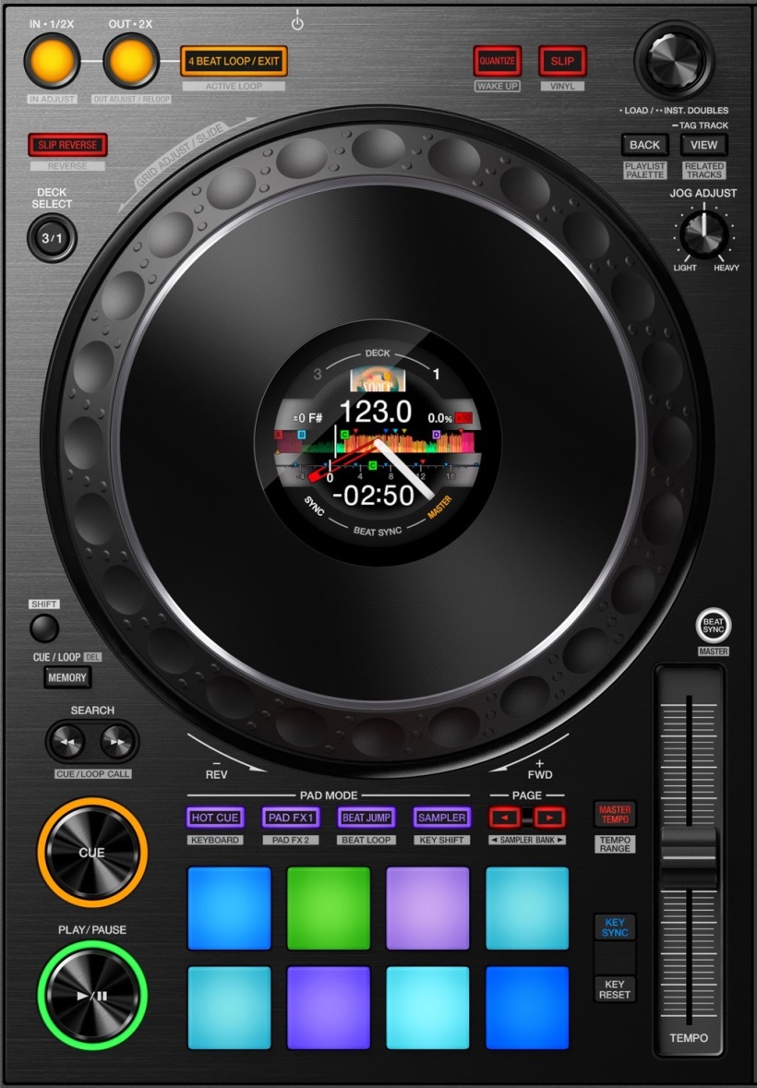
DDJ-1000: Pad modes
HOT CUE
(Cancel JogFX)
PAD FX
(twice = cycle)
MACRO FX (twice =cycle)
JOG FX
Cycle pages
Select page
KEYBOARD
BEATJUMP / LOOPS
SLICER
REMIX DECKS
Most modes have sub-pages:
Press “mode” to cycle the top 2 pages
Press “<” to cycle all pages one by one
Press “>” to select a specific page
Press “shift” to select a specific page

Slide 2
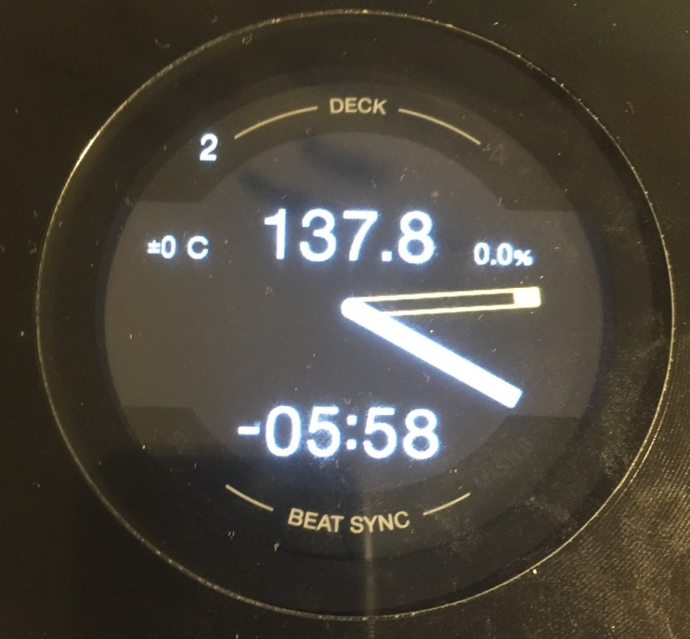
DDJ-1000: Jog Screens
Current BPM / Base BPM
Current Tempo / Tempo range /
Soft takeover (blinks)
Phase error
Cue Needle
Time Elapsed / Remain Loop / BeatJump Size
Play Needle
Sync
Master
Preview base BPM, Tempo range and loop sizes
(Double Tap)
Toggle elapsed/remain
(Long press)
+
Screens Reset
Total time
+
Set Tempo range

Slide 3
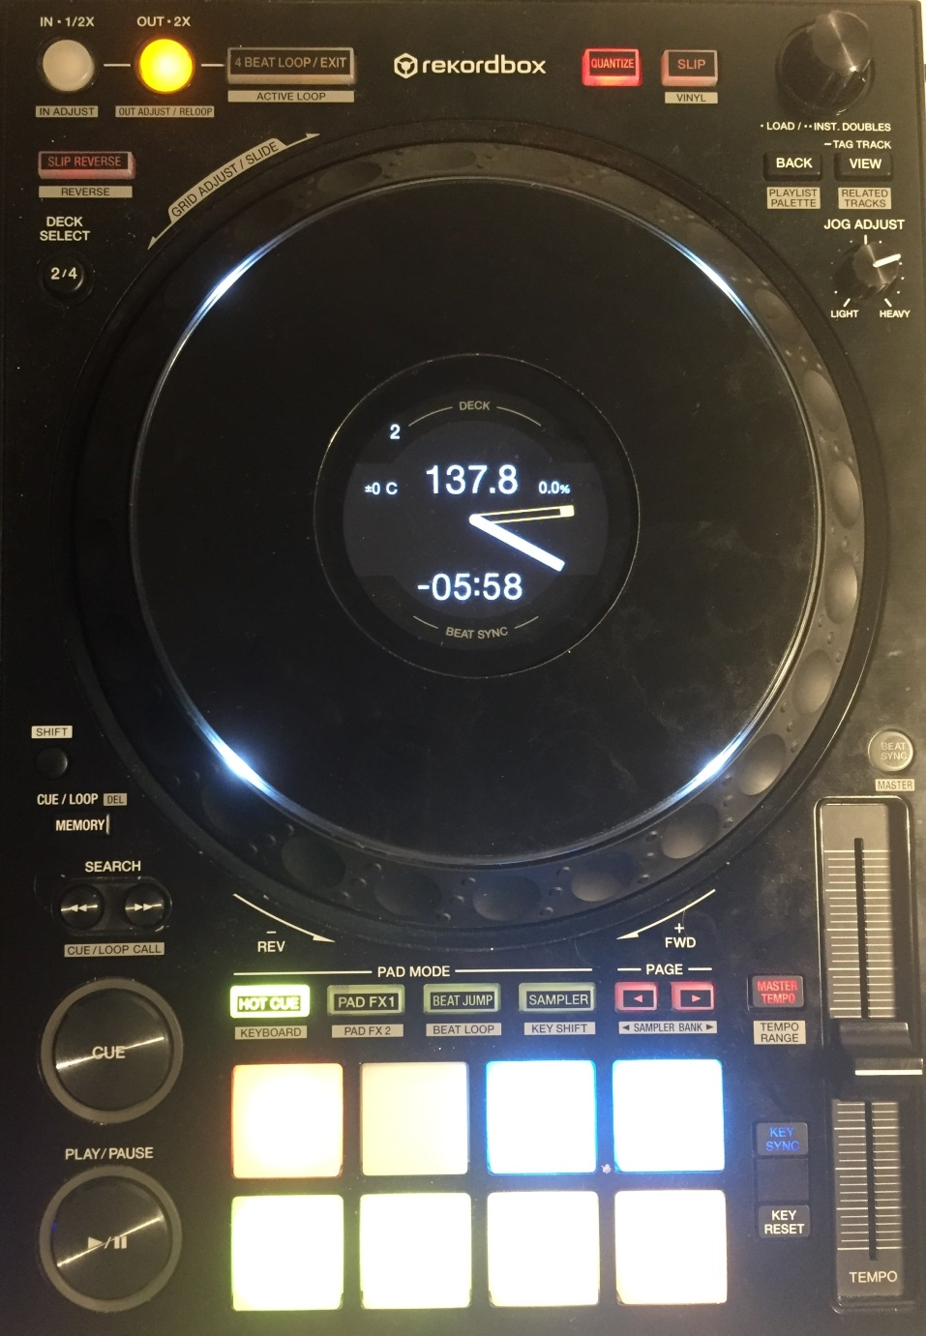
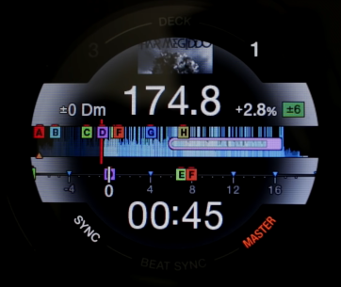
DDJ-1000: Jog Screens and LEDs
RESET SCREENS
Show Loop size / Show BeatJump Size
Vinyl On/Off
On-Air Deck /
End of track warning
JogFX enabled
Show Tempo Range, Base BPM, Loop sizes
Tempo Range Toggle Time Elapsed / Remain
Toggle Elapsed & Remain
Tempo adjust
CUE flashes when a new cue can be set
(Comparison with HID screens)
PLAY flashes when in pause mode

Slide 4
DDJ-1000: General overview - Deck
Quantize + Snap (toggle)
CDJ mode (per deck)
4-beat Loop / Active Loop / Move 1-beat
List Browse / Tree Browse Zoom / Preview player
LoopSize / MoveSize / BeatJump
Only Browser (toggle)
TP3 Slip Reverse
Preview Player
(using browser)
Layout change
JogFX / Quick Search
CDJ / Grid Adjust
Main shift
Second shift
Sync Toggle / Sync Off / Master
Not used
Track begin
Keylock / 6%->10%->16%->100%
Vinyl Stop / Release FX
BPM Slide / Set Marker / Auto
Key reset / BPM Adjust Reset Marker / Lock

Slide 5
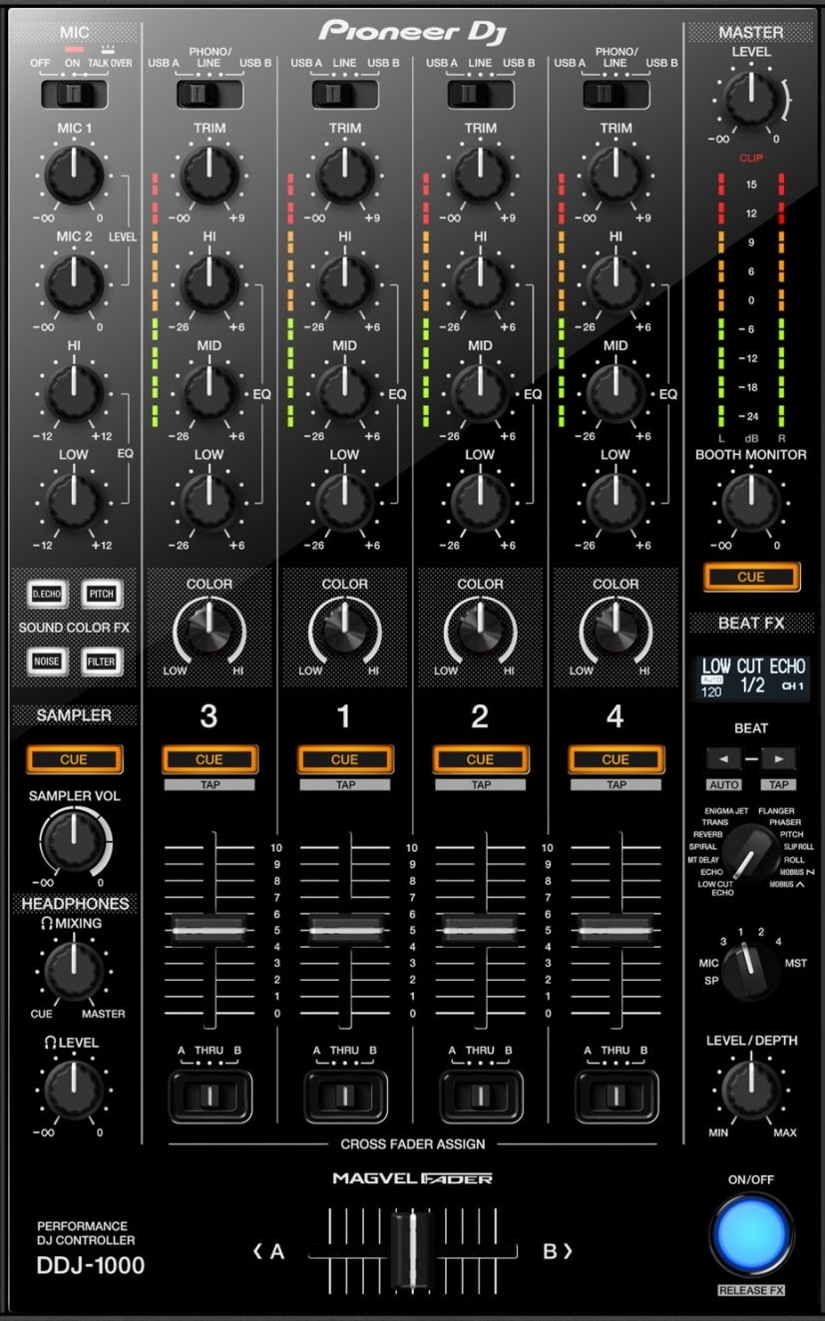
DDJ-1000: General overview - Mixer
MixerFX2
MixerFX1+5
MixerFX3
MacroFX / MixerFX
Filter
FX Parameter / Single+Group
UserFX / Pioneer FX (in master mode)
JogFX+MacroFX DryWet
FX Routing
Dry Wet /
FX Parameter
FX ON+OFF

Slide 6
DDJ-1000: MixerFX and UserFX
Dlb delay
T. Gater
Noise
Both mixerFX + MacroFX
Regular: FX Parameter
+shift: Single Group
UserFX Pioneer effects (MST)
Crush
Filter
Dry/Wet MacroFX + JogFX
FX Routing
Regular: DryWet
+shift: FX Parameter
MacroFX (twice=cycle)
FX ON+OFF

Slide 7
DDJ-1000: MixerFX and UserFX
MacroFX / Mixer FX
MixerFX2
Regular: FX Parameter
+shift: Single Group
Regular:MixerFX1
+shift:MixerFX5
MixerFX3
UserFX Pioneer effects (MST)
Filter
FX Routing
JogFX+MacroFX DryWet
Regular: DryWet
+shift: FX Parameter
FX ON+OFF
MacroFX (twice=cycle)

Slide 8

DDJ-1000: Loop Section
Regular: Loop In
Loop Engaged: 1/2x
Regular: Loop Out
Loop Engaged: 2x
4-beat Loop
Loop Exit
Whole loop adjust mode +memory: Loop In adjust mode
Loop out adjust mode
Loop activate
+
Select 1/2x
Select 2x
AutoLoop (selected size)
+

Slide 9
DDJ-1000: BeatJump Section
Select Size 1/2
Select Size 2x
Beatjump left Loop move left
Beatjump right Loop move right
+
Beatjump 1-beat left Loop 1-beat left
Beatjump 1-beat right Loop 1-beat right
+

Slide 10

DDJ-1000: Sync Section
TRAKTOR MODE
SERATO MODE
ELASTIC GRID MODE
Preferences / Transport
BeatSync
Tempo Sync
BeatSync
Toggle ON/OFF
Sync On
Sync On
Sync On
Sync Off
+
Set master deck
+
Sync Off
+
+
Toggle between 3x sync modes

Slide 11
DDJ-1000: Deck layout
Toggle 2-deck / 4-deck view
(Double Tap)
+
Toggle Parallel / Classic view
+
Enable/ disable layout change

Slide 12
DDJ-1000: Browser
Turn: Browse List Press: Load Track
(BROWSER)
Load+Start Preview player
Only browser
Turn: Scroll Tree Press: Expand Folder
(BROWSER TREE)
+
Scroll Favorites
Goto Collection
Turn: Seek Preview player Press:
(PREVIEW PLAYER)
+
Load/Unload Preview player
Turn: Zoom deck Press: Zoom reset
(DECK ZOOM)
+

Slide 13
DDJ-1000: Transport
Main shift
Second shift
regular: Cue
+shift: Move to font
regular: Pause
+shift: Vinyl quick stop
+memory: Vinyl long stop
+shift: Unload deck

Slide 14
DDJ-1000: Beatgrid
+shift: BPM set
+Jog: grid slide
+KeyReset: BPM Auto
Regular: key reset
+shift: BPM delete
+Jog: grid adjust
+KeySync: Analysis Lock

Slide 15
DDJ-1000: Mapping Settings
+
+
Toggle Traktor/Serato sync mode
+
+
Toggle Monitor cue external/internal
+
Screens Reset
+
Cross-fader curve select
+
+
Deck Unload
+
Crossfader Curve Adjust

Slide 16
DDJ-1000: Pad modes
HOT CUE
(Cancel JogFX)
PAD FX
(twice = cycle)
MACRO FX (twice =cycle)
JOG FX
Cycle pages
Select page
KEYBOARD
BEATJUMP / LOOPS
SLICER
REMIX DECKS
Most modes have sub-pages:
Press “mode” to cycle the top 2 pages
Press “<” to cycle all pages one by one
Press “>” to select a specific page
Press “shift” to select a specific page

Slide 17
DDJ-1000 mode #1: HotCues
HOTCUE
Cue 1
Cue 2
Cue 3
Cue 4
Cue 5
Cue 6
Cue 7
Cue 8
Use shift to delete hot cues
Hotcues move temporary cue as well

Slide 18
DDJ-1000 mode #2: PadFX and Rolls
MAIN PAGES:
EXTRA PAGES:
Rolls
PadFX 2
Roll 1/8
Roll 1/4
Roll 1/2
Roll 1/1
Delay #1
Delay #2
Delay / BeatSlicer
Flanger Flux
Roll 1/8
(NQ)
Roll 1/4
(NQ)
Roll 1/2
(NQ)
Roll 1/1
(NQ)
Lofi / Slicer #1
Lofi / Slicer #2
BeatSlicer
Release FX (toggle)
PadFX 1
PadFX 3
Gater #1
Gater #2
Gater #3
Peak Filter
Filter Pulse
LaserSlicer
Bass-O-Matic #1
Bass-O-Matic #2
Beat
Masher #1
Beat
Masher #2
Zzzurp
Release FX (toggle)
Bouncer / EventH
Bouncer
EventH
Release FX (toggle)
Use mode button to cycle top two pages
Use “<“ arrow to cycle all pages
Use “>” or “shift” to select a specific page

Slide 19
DDJ-1000 mode #3: MixerFX and MacroFX
MAIN PAGES:
Dlb delay
T. Gater
Macro FX1
Noise
Both mixerFX + MacroFX
MacroFX: WormHole
MacroFX: PolarWind
MacroFX: FlightTest
MacroFX: LaserSlicer
Crush
Filter
BeatFX: Delay T3
BeatFX: Flanger
BeatFX: Reverb
Toggle On/OFF
Dry/Wet MacroFX + JogFX
MacroFX2
MixerFX
Event Horizon
Zzzuurp
Dark
Matter
Bass O Matic
MixerFX: Dbl Delay
MixerFX: TimeGater
MixerFX: Crush
MixerFX: Noise
Strrretch (Slow)
Strrretch (Fast)
Granu Phase
Toggle On/OFF
Filter
Use mode button to cycle top two pages
Use “<“ arrow to cycle all pages
Use “>” or “shift” to select a specific page

Slide 20

DDJ-1000 mode #4: JogFX
Jog FX
JOG FX
Beatmasher Digital filter Gater
Beatmasher Filter Reverb
EventHorizon
(none) Gater
Gater Beatmasher Reverb
Flanger (None) Gater
Beatmasher Peak filter Gater
FormatFilter Peak filter Flightest
Enter jogFX mode on mode4 (jog will blink)
Touch jog to apply FX
Turn jog to change FX
Release jog to stop FX
Sampler volume to Dry/Wet
Call “hotcues” to cancel jogFX (=scratch mode)

Slide 21
DDJ-1000 mode #5: Tone Play
TONE PLAY
TONE PLAY
+4
+5
+6
+7
+12
= 0
Inc
Dec
= 0
+1
+2
+3
+8
+9
+10
+11
Use shift to choose between 3x modes:
TONE PLAY
N/A
Cue And Play mode
Cue mode
Play mode
Key reset

Slide 22
DDJ-1000 mode #6: BeatJumps and Loops
BEATJUMP
LOOP
Jump -1
Jump +1
Jump -4
Jump +4
Loop 4
Loop 2
Loop 1
Loop 1/2
Jump -8
Jump +8
Jump -16
Jump +16
Loop 4
Loop 8
Loop 16
Loop 32
Use “<“ arrow to select beatjump mode
Use “>” arrow to select loop mode

Slide 23
DDJ-1000 mode #7: Slicer
SLICER
Slicer #1
Slicer #2
Slicer #3
Slicer #4
Slicer #5
Slicer #6
Slicer #7
Slicer #8
Use shift to choose between 3x modes:
SLICER
8 slices whole
16 slices odd
16 slices even

Slide 24
DDJ-1000 mode #8: Sampler
SAMPLER
Cell #1
Cell #2
Cell #3
Cell #4
Cell #5
Cell #6
Cell #7
Cell #8
Use shift to mute / Toggle 1-shot
SAMPLER
Mute #1
Mute #2
Mute #3
Mute #4
Loop / 1-shot #1
Loop / 1-shot #2
Loop / 1-shot #3
Loop / 1-shot #4

